Slide 1

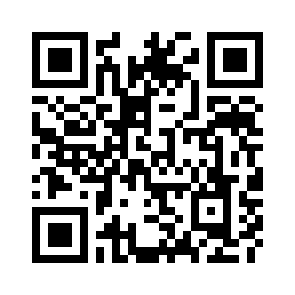
Toward the Holy Grail of Automated Fact-checking
Chengkai Li
University of Texas at Arlington
SXSW, March 13, 2017

Slide 2
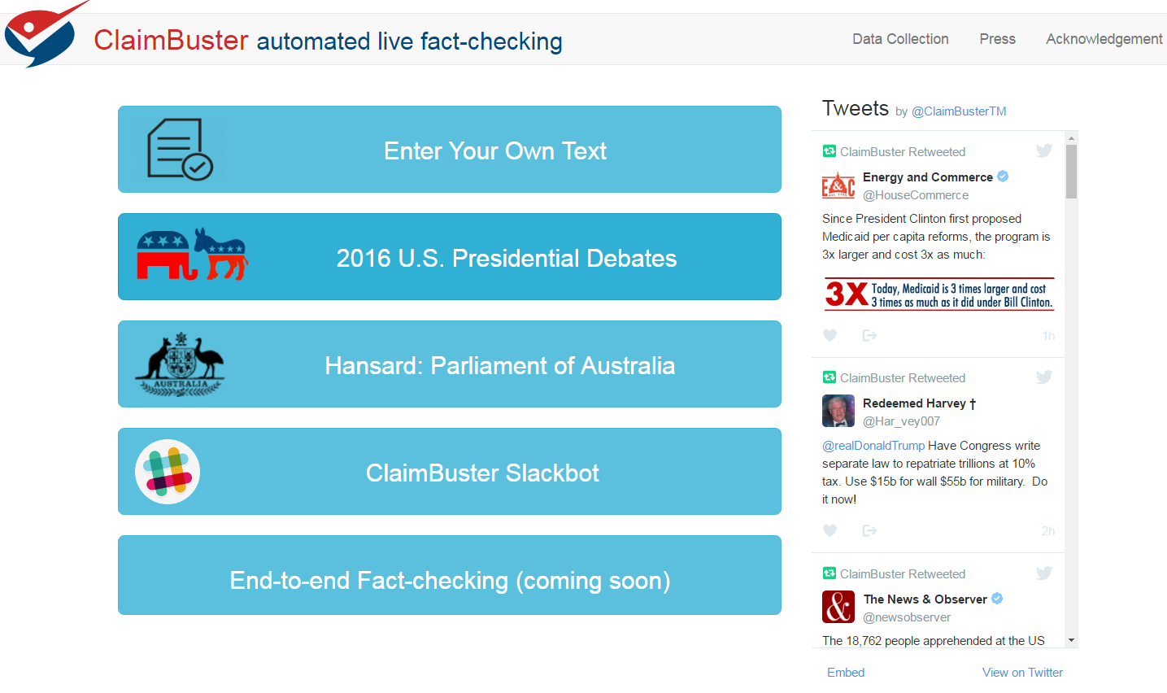

Slide 3
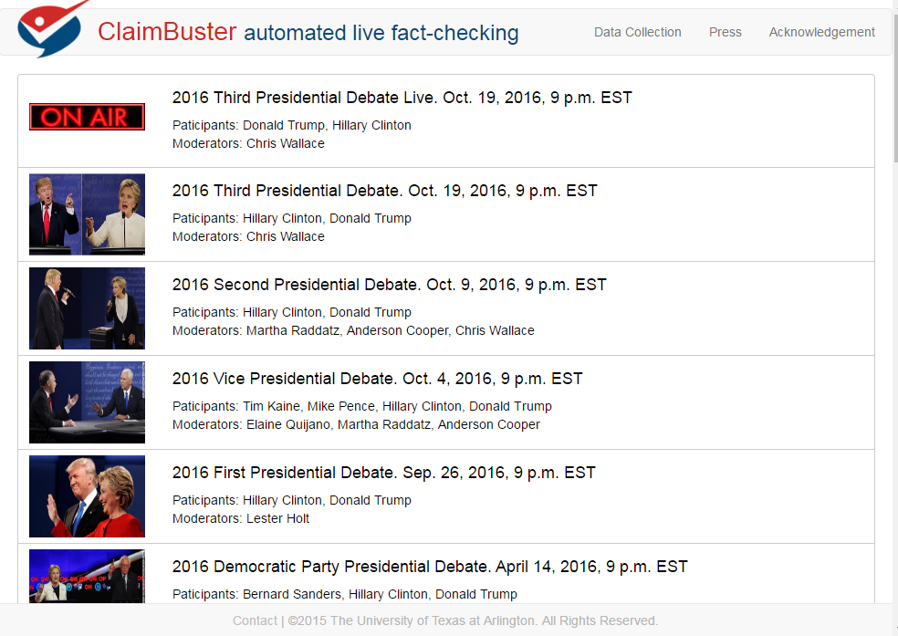

Slide 4
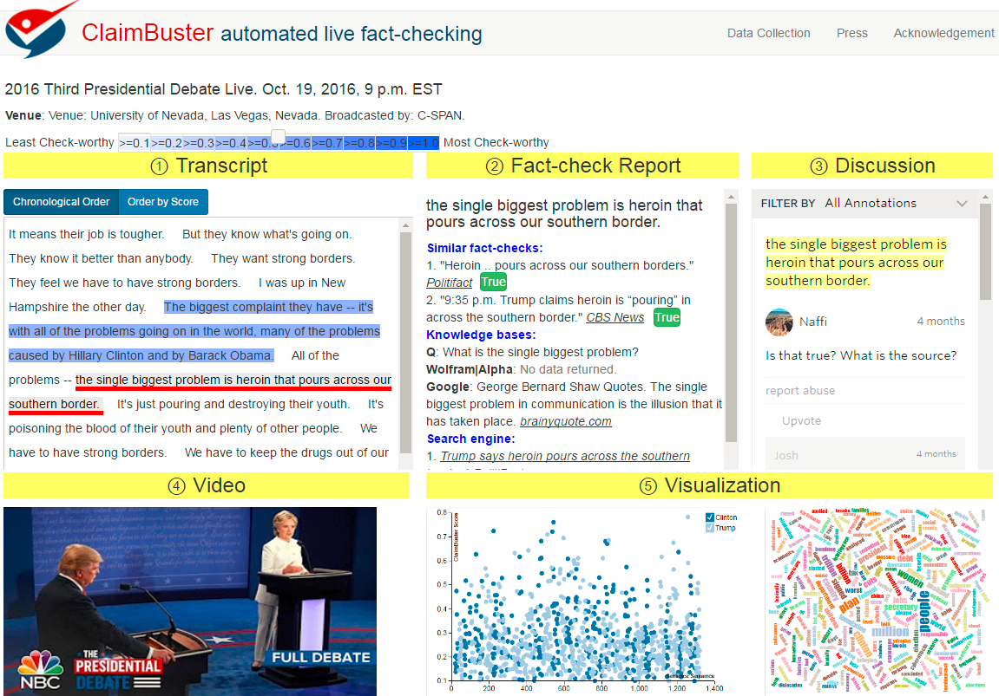

Slide 5
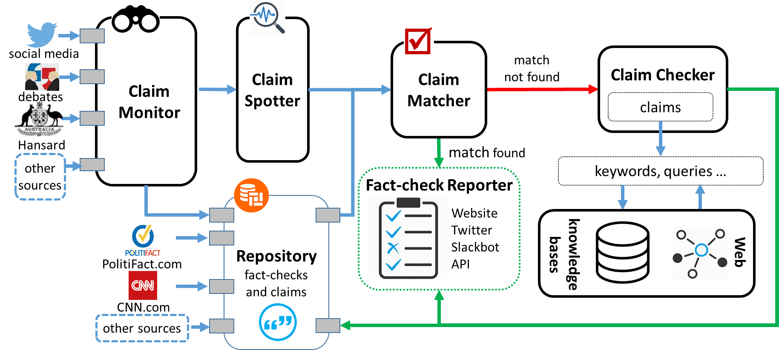
The First-ever End-to-end System

Slide 6
